Slide 1

Embracing Tension and Transitions:
Seven Essentials for Effective Leadership
Dr. Lebron Fairbanks

Slide 2

of Leadership…
The JOY
… and then!

Slide 3
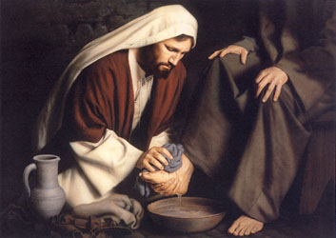
“Leading for change is not the same as exercise of power.”
George M. Burns,
Leadership p. 9-28

Slide 4

How do we LEAD with the mind of Christ when tensions
arise over change & transitions?

Slide 5


VISION OF THE FUTURE
LEADERSHIP

Slide 6
VISION OF THE FUTURE
PAIN OF LEADERSHIP
REALITY OF THE PRESENT

Slide 7
VISION OF THE FUTURE
PAIN OF LEADERSHIP
REALITY OF THE PRESENT

Slide 8
VISION OF THE FUTURE
PAIN OF LEADERSHIP
REALITY OF THE PRESENT

Slide 9
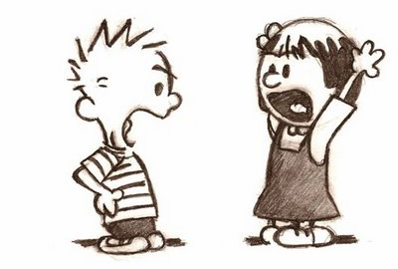
Good and godly people most often collide over TRADITIONS, VISION, and VALUES in the faith community.

Slide 10

what
does it really mean,
to LEAD
a divided faith community, with the mind of Christ?

Slide 11
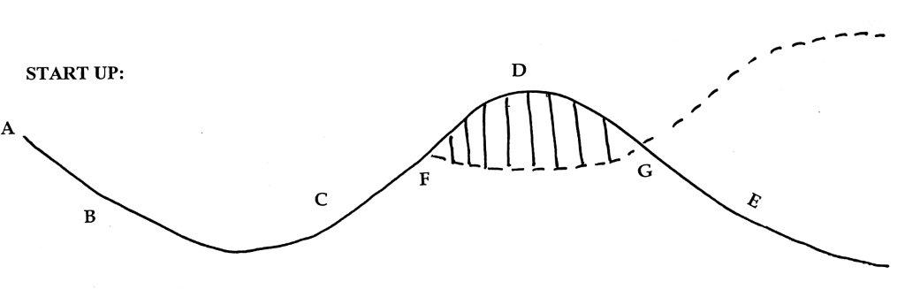
SIGMOID CURVE

Slide 12
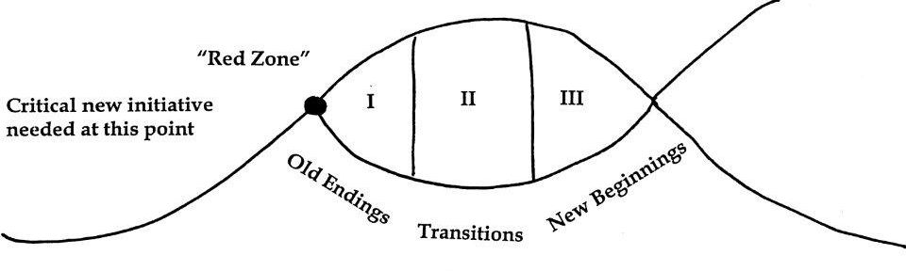
Break out Point of F and G

Slide 13
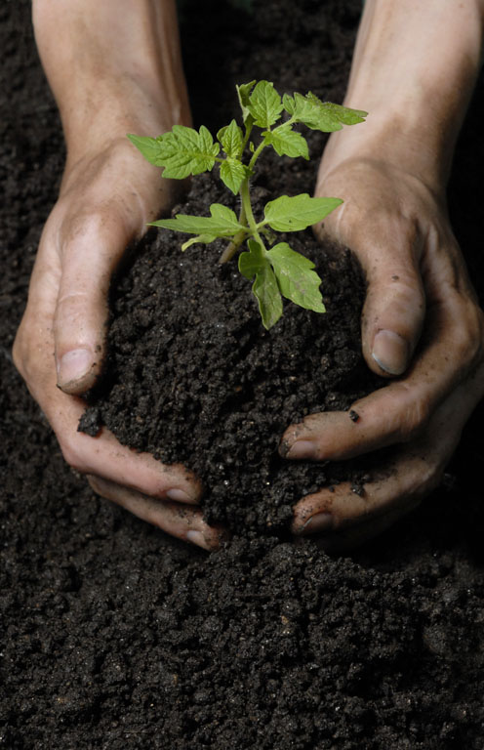
Regarding the transition period, the leader must model consistency, steadiness, integrity, respect, trust, and communication.

Slide 14

Where are you as leader and where is your congregation in the cycle?
What should be the role of leadership, regarding “F” and “G” alone?

Slide 15

“VISION” has to do with seeing things clearly and at a great distance.”
Regarding the VISION thing…
A VISION is a “consuming, passionate, and compelling inner picture.

Slide 16
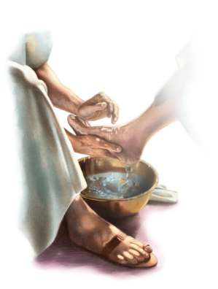
Blessed is the person who is captured by a big, God-inspired” vision, and is willing to pay the price to see that vision comes true

Slide 17

Change for us is inevitable. Problems arise in the
TRANSITIONS.
We want and need for these transitions to be transformative; not destructive and divisive.

Slide 18

A turnaround vision can be transforming
for a faith community,
and flow
from our living
and leading
with the
Mind of Christ!

Slide 19

Anchor # 1:
SPEAK GRACEFULLY
Issue:
“Watch the words
we speak”
Principle:
Words we speak can bless or “destroy” people.

Slide 20
As leaders through the words we use, we either:
Encourage or discourage those with
whom we work.
Lift them up or put them down.
Speak positively or negatively about
them.
Reflect cultural sensitivity or
cultural “blindness” to them.
Focus on “them” or focus on self.

Slide 21
I often ask myself: how do others feel when they leave my presence?
Stronger or weaker?
Larger or smaller about
themselves?
Confident or “scared”?
Understood or misunderstood?
Affirmed or manipulated?
Blessed or “destroyed”?

Slide 22

PRAISE to CRISTICISM ratio
80-90% praise or positive statements
10-20% criticism or negative statements
-Sven Walroos, clinical psychologist.

Slide 23

Anchor # 2:
LIVE GRATEFULLY
Issue:
Comparison is the root of inferiority
Principle:
“Don’t whine-
be grateful”

Slide 24

COMPARISON can
eat
us
alive…
…and rob us of joy, relationships, Confidence and peace.
In the process, it saps our energy and drains us of enthusiasm

Slide 25
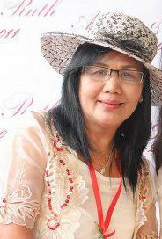
Gratitude is the
“life-giving” antidote to the negative impact of comparison

Slide 26
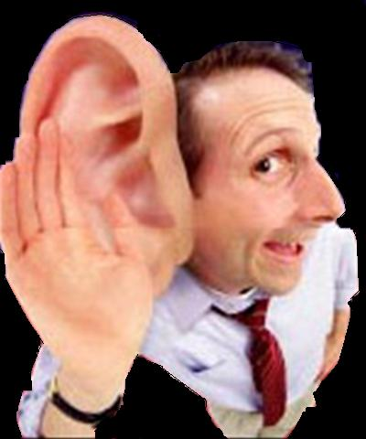
Anchor # 3:
LISTEN INTENTLY
Issue:
“Seek first
to understand”
Principle:
Understanding, not agreement, is the key to conflict management

Slide 27

theological vision (what I believe about people / what I “see” in them) precedes organizational vision. (What I want for the church, district, field or region.)
“God, please give me
Your eyes and ears to
really ‘see’ and ‘hear’
the people
with whom I work.”

Slide 28
two growth producing questions:
  “What can I learn?
  “How can I change?”
two growth inhibiting questions:
  “Why me?
  “What if…?”

Slide 29
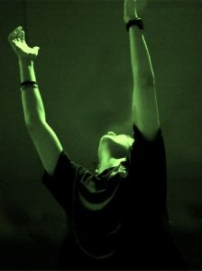
Anchor # 4:
FORGIVE FREELY
Issue:
Be proactive in
extending forgiveness
Principle:
A spirit of forgiveness transforms and empowers leaders

Slide 30
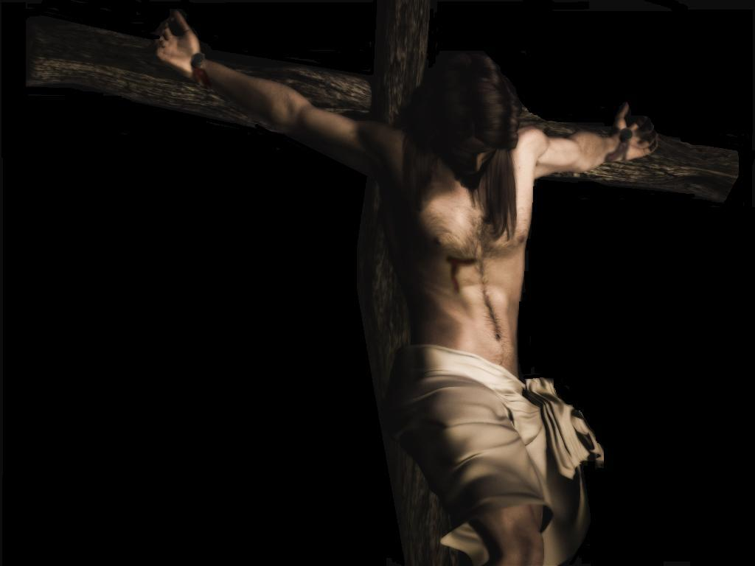
“Father, forgive them, for they do not know what they are doing”
Luke 23:34 (NIV)
Notes:
30

Slide 31

“Great leaders,” we are told,
“are shaped
in the most challenging and difficult times.”

Slide 32
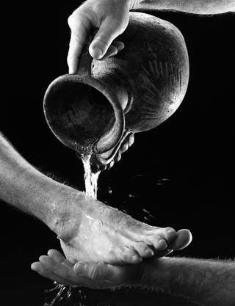
Anchor # 5:
LEAD DECIVELY
Issue:
Christian leaders combine deep humility, clear vision,
and fierce resolve
Principle:
Our holiness testimony is reflected in and through the way we make and implement decisions

Slide 33

If decisive leaders are to move from the preferred vision to achieved results, they must give passionate attention to the leadership roles of:
Dreaming and planning
Organizing and administering
Motivating and encouraging
Evaluating and reviewing

Slide 34
PLANNING CYCLE
1. Understand
your Mission:
OVERARCHING
MISSION STATEMENT
4. Implement your plan:
COMPREHENSIVE IMPLEMENTATION PLAN
Continually review and revise your strategy:
REVIEW AND REVISE
2. Asses your Situations
SITUATION ASSESSMENT
3. Develop your Goals:
PERSONAL/
PROFESSIONAL
GROWTH GOALS

Slide 35

Leaders who inspire others…
.. are deciders rather than drifters.
.. know where they are going, and
how they are going to get there.
3… are results-oriented and not just
activity-oriented.
4… establish growth goals, and are
among the 3% who write down
these goals.

Slide 36
Leaders who inspire others…
5… pursue goal setting in the context
of a broader planning strategy.
6… develop a mission statement, and
are mission-driven.
7… dream great, God-inspired
dreams, and understand
leadership is the transference
of vision. A goal is a
dream with a deadline.

Slide 37
Leaders who inspire others…
8… are constantly involved in an
ongoing (SWOT) analysis of
their constituents.
9… work hard at detailing
programs and plans.
10…continually reviews and
revises the planning strategy
for growth.

Slide 38
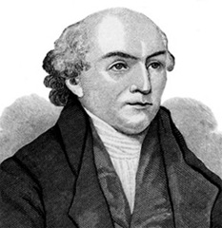
“Expect great things from God
and attempt great things
for God.”
-William Carey

Slide 39
We move ahead -- decisively – through:
prayer, with them, for them and for “me” as leader;
collaboration, involving them when and where we can in the process;
and with gratitude, thanking God, and “them” for their gifts, talents, abilities and testimony of faith in Jesus as Lord.

Slide 40

To lead decisively with Christian humility, develop and nurture:
____ Listening and communicating skills
____ Timing and processing skills
____ Affirming and encouraging skills
____ Asking and Inquiring skills
____ “Gift” discernment
and delegation skills

Slide 41

Anchor # 6:
LOVE DEEPLY
Issue:
Value people not power (or position)
Principle:
The evidence of leadership is seen in the lives of the followers

Slide 42

Focus on the things
that unite us,
not divide us.

Slide 43
Leaders who inspire others…
_____ #1. Set Clear Standards (or
Expectations)
___ #2. Expect the Best
___ #3. Pay Attention
___ #4. Personalize Recognition
___ #5. Tell the Story
___ #6. Celebrate Together
___ #7. Set the Example
ENCOURAGING THE HEART
James Kouzes and Barry Posner

Slide 44

Anchor # 7:
PRAY EARNESTLY
Issue:
Some issues are resolved only through prayer and dependence on God
Principle:
Recognize that God can work in us to become the change we desire to see in others

Slide 45
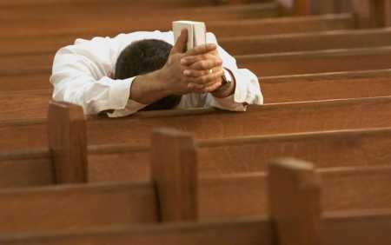
In the midst of experiencing honest and intense differences
between good and godly people, the “pray-er” can be changed and transformed!

Slide 46
“Leaders with the mind of Christ seek to humbly lead others, for the purpose of inspiring and enabling them, through teaching, collaboration, and example, to live their lives under the Lordship of Christ, and to understand, accept, and fulfill their ministry to each other, their vocational mandate, and their mission in the world.”
ELF- Definition of Christian Servant Leadership

Slide 47
Collins speak of “humility and fierce resolve as essential for Level 5 or top leaders.” You will also discover that Christian servant leaders…
__1. Speak Gracefully. Watch the words you speak
__ 2. Live Gratefully. Don’t whine, be grateful
__ 3. Listen Intently. Seek first to understand
__ 4. Forgive Freely. Be proactive in extending forgiveness
__ 5. Lead Decisively. Combine deep humility with fierce resolve
__ 6. Love Deeply. Value people, not power
__ 7. Pray Earnestly. Become the change you desire to see in others.

Slide 48

What
new vision,
big goal,
or renewed passion has God given to you today?

Slide 49

“Whatever happens, conduct yourselves in a manner worthy of the Gospel of Christ.” Philippians 1:27
This is the spirit of holiness:
Live and lead
with the mind of Christ.

Slide 50


